Slide 1
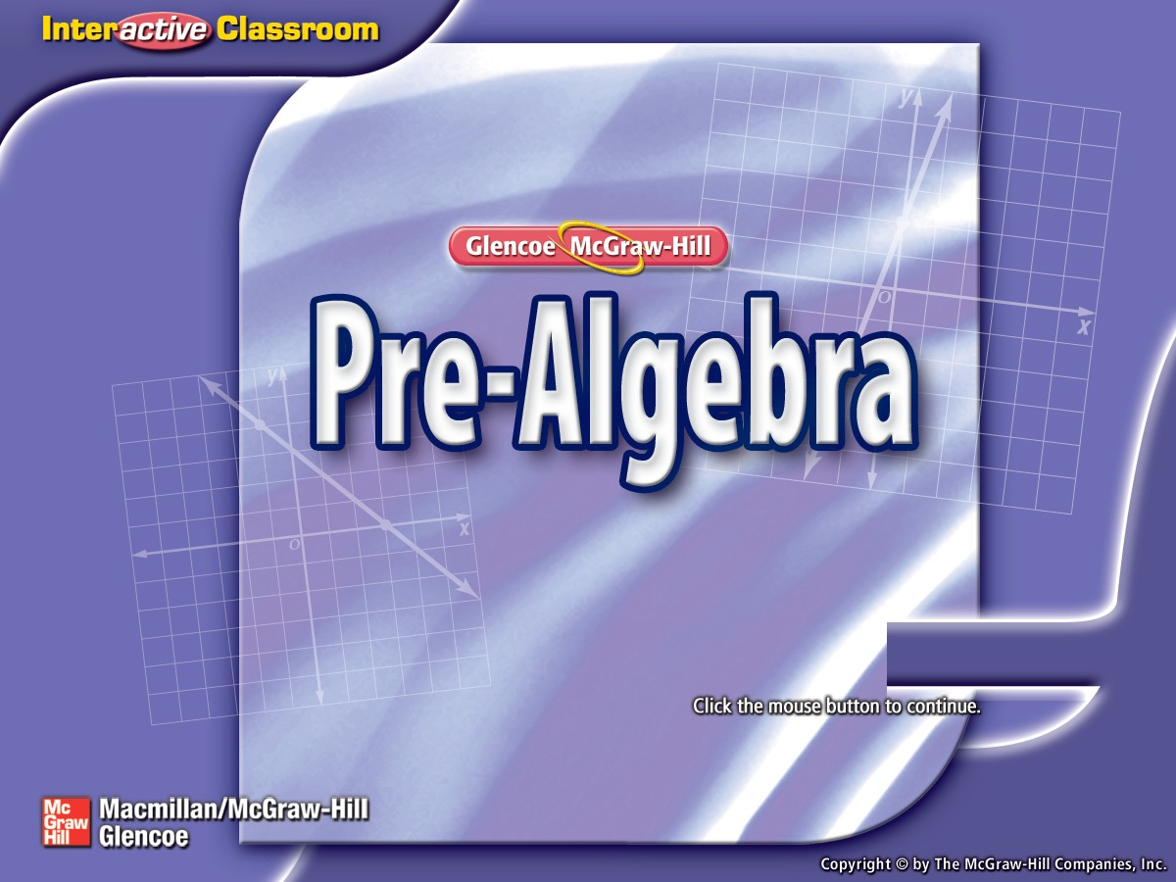


Splash Screen

Slide 2
Lesson Menu
Five-Minute Check (over Lesson 4–3)
Then/Now
Key Concept: Division Property of Equality
Example 1: Solve Equations by Dividing
Example 2: Solve Equations by Dividing
Example 3: Real-World Example: Solve an Equation by Dividing
Key Concept: Multiplication Property of Equality
Example 4: Solve Equations by Multiplying
Example 5: Solve Equations by Multiplying by the Reciprocal

Slide 3

5-Minute Check 1
Solve x – 3 = –6. Check your solution.
A. 9
B. 3
C. –3
D. –9

Slide 4

5-Minute Check 2
Solve y + 9 = 7. Check your solution.
A. 2
B. –2
C. –7
D. –16

Slide 5

5-Minute Check 3
Solve 23 = m – 6. Check your solution.
A. –29
B. –17
C. 17
D. 29

Slide 6

5-Minute Check 4
Solve y – 7 = 17. Check your solution.
A. 24
B. 10
C. –10
D. –24

Slide 7

5-Minute Check 5
Solve –13 = x – 9. Check your solution.
A. 22
B. 4
C. –4
D. –22

Slide 8

5-Minute Check 6
Lance is 65 inches tall. This is 6 inches taller than Rebecca. Write and solve a subtraction equation to find Rebecca’s height in inches.
A. r – 6 = x, r – 6 = 65, r = 71 in.
B. r = x – 6, r = 65 – 6, r = 59 in.
C. r = x + 6, r = 65 + 6, r = 71 in.
D. r = 6 – x, r = 6 – 65, r = –59 in.

Slide 9


Then/Now
You have already solved equations using addition and subtraction. (Lesson 4–3)
Solve equations by using the Division Property of Equality.
Solve equations by using the Multiplication Property of Equality.

Slide 10
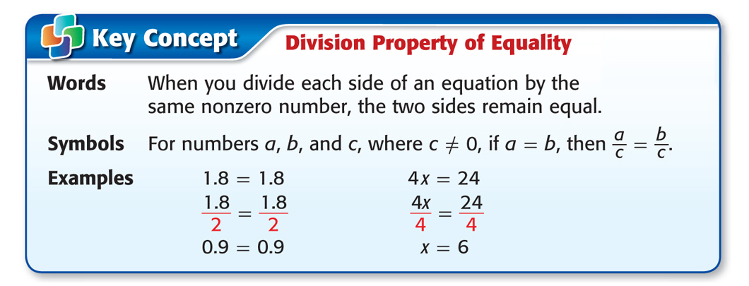
Concept A

Slide 11
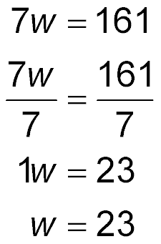
Example 1
Solve Equations by Dividing
Solve 7w = 161.
Write the equation.
Division Property of Equality
7 ÷ 7 = 1, 161 ÷ 7 = 23
Identity Property; 1w = w
Answer: The solution is 23.

Slide 12


Example 1
Solve 12p = 120.
A. –132
B. –10
C. 10
D. 132

Slide 13

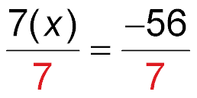
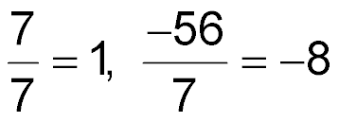


Example 2
Solve Equations by Dividing
Solve 7x = –56. Check your solution and graph it on a number line.
Write the equation.
Division Property of Equality
Identity Property; 1x = x

Slide 14





Example 2
Solve Equations by Dividing
To check your solution, replace x with –8 in the original equation.
Check Write the equation.
?
Replace x with –8.
The sentence is true.
Answer: The solution is –8.

Slide 15
Example 2
Solve 4x = –12. Check your solution.
A. –48
B. –3
C. 3
D. 48

Slide 16
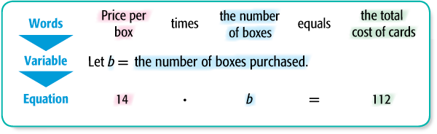
Example 3
Solve an Equation by Dividing
HOBBIES Esteban spent $112 on boxes of baseball cards. He paid $14 per box. Write and solve an equation to find how many boxes of cards Esteban bought.
.

Slide 17
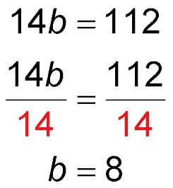
Example 3
Solve an Equation by Dividing
Write the equation.
Division Property of Equality
Simplify.

Slide 18
Example 3
Solve an Equation by Dividing
To check your solution, replace b with 8 in the original equation.
Check 14b = 112 Write the equation.
?
14(8) = 112 Replace b with 8.
112 = 112 The sentence is true.
Answer: Therefore, Esteban bought 8 boxes of cards.

Slide 19
Example 3
DOUGHNUTS Eliza spent $27 on doughnuts. She paid $3 per dozen. Write and solve an equation to find how many dozens of doughnuts Eliza bought.
A. 3d = 27, 9 dozen
B. 27d = 3, 9 dozen
C. 9d = 27, 3 dozen
D. 27d = 9, 3 dozen

Slide 20
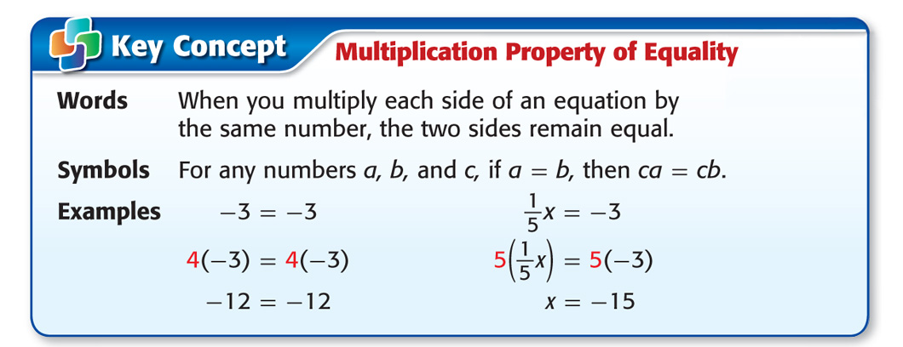
Concept B

Slide 21
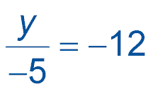
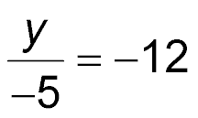
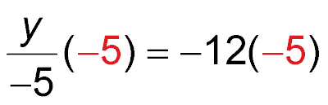

Example 4
Solve Equations by Multiplying
Solve . Check your solution.
Write the equation.
Multiplication Property of Equality
Simplify.

Slide 22
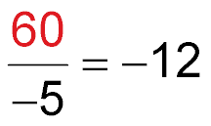

Example 4
Solve Equations by Multiplying
Check
Write the equation.
?
Replace y with 60.
The sentence is true.
Answer: The solution is 60.

Slide 23
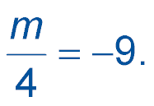

Example 4
Solve Check your solution.
A. –36
B. –5
C.
D. 36

Slide 24
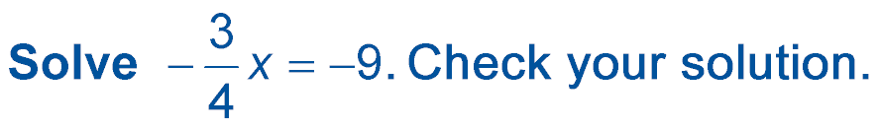
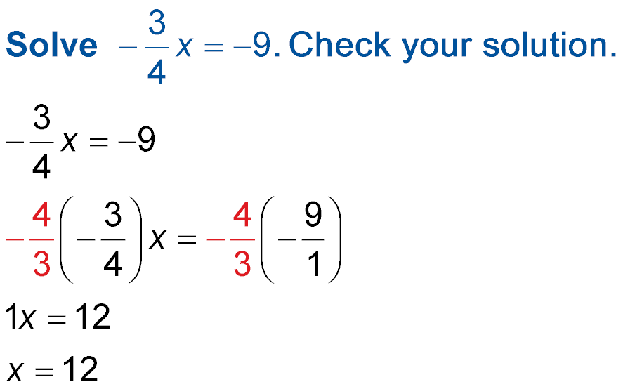
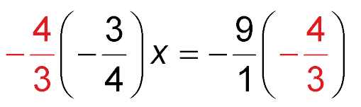
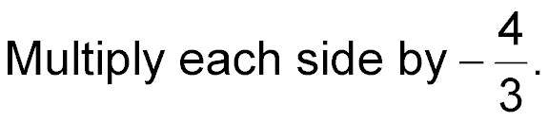
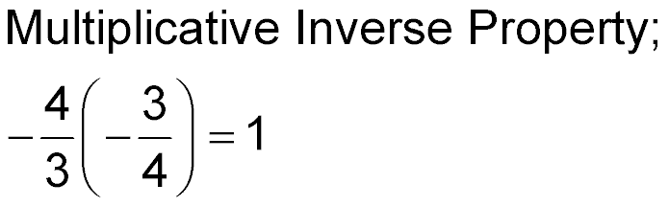
Example 5
Solve Equations by Multiplying by the Reciprocal
Write the equation.
1x = 12
Identity Property

Slide 25
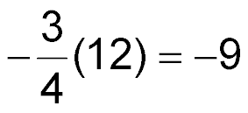
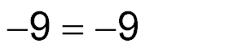
Example 5
Solve Equations by Multiplying by the Reciprocal
Check
Write the equation.
?
Replace x with 12.
✓
The sentence is true.
Answer: The solution is 12.

Slide 26
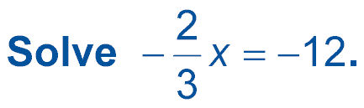
Example 5
A. –18
B. –8
C. 8
D. 18

Slide 27
End of the Lesson

